Slide 1

IMPORTSNT QUESTIONS- OPERATING SYSTEM
BY MALVIKA KAUSHIK

Slide 2
What is difference between an OS and kernel?
Operating System:
It is a system program that provides interface between user and computer. When computer boots up Operating System is the first program that loads.
Kernel:
A kernel is the core component of an operating system. It is also a system program. It is the part of Operating System which converts user commands into machine language.

Slide 3
Operating System | Kernel
Operating System is a system software. | Kernel is system software which is part of operating system.
Operating System provides interface between user and hardware. | Kernel provides interface between applications and hardware.
It also provides protection and security. | It’s main purpose is memory management, disk management, process management and task management.
All system needs operating system to run. | All operating systems need kernel to run.
Type of operating system includes single and multiuser OS, multiprocessor OS, Realtime OS, Distributed OS. | Type of kernel includes Monolithic and Micro kernel.
It is the first program to load when computer boots up. | It is the first program to load when operating system loads.

Slide 4
virtual memory
Virtual memory is a memory management technique where secondary memory can be used as if it were a part of the main memory.
Virtual memory is a common technique used in a computer's operating system (OS).
Virtual memory uses both hardware and software to enable a computer to compensate for physical memory shortages, temporarily transferring data from random access memory (RAM) to disk storage.
Mapping chunks of memory to disk files enables a computer to treat secondary memory as though it were main memory.

Slide 5
Process
A process is basically a program in execution. The execution of a process must progress in a sequential fashion.
A process is defined as an entity which represents the basic unit of work to be implemented in the system.

Slide 6
Process Life Cycle
When a process executes, it passes through different states. These stages may differ in different operating systems, and the names of these states are also not standardized.

Slide 7
S.N. | State & Description
1 | Start This is the initial state when a process is first started/created.
2 | Ready The process is waiting to be assigned to a processor. Ready processes are waiting to have the processor allocated to them by the operating system so that they can run. Process may come into this state after Start state or while running it by but interrupted by the scheduler to assign CPU to some other process.
3 | Running Once the process has been assigned to a processor by the OS scheduler, the process state is set to running and the processor executes its instructions.
4 | Waiting Process moves into the waiting state if it needs to wait for a resource, such as waiting for user input, or waiting for a file to become available.
5 | Terminated or Exit Once the process finishes its execution, or it is terminated by the operating system, it is moved to the terminated state where it waits to be removed from main memory.

Slide 8
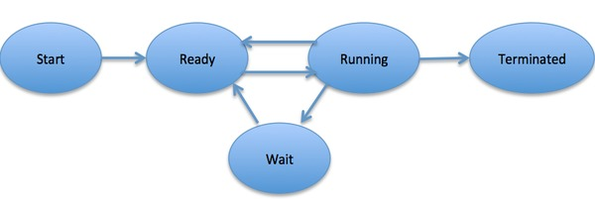

Slide 9
PCB
While creating a process the operating system performs several operations. To identify the processes, it assigns a process identification number (PID) to each process.
As the operating system supports multi-programming, it needs to keep track of all the processes. For this task, the process control block (PCB) is used to track the process’s execution status.
Each block of memory contains information about the process state, program counter, stack pointer, status of opened files, scheduling algorithms, etc.
All these information is required and must be saved when the process is switched from one state to another.
When the process makes a transition from one state to another, the operating system must update information in the process’s PCB.

Slide 10
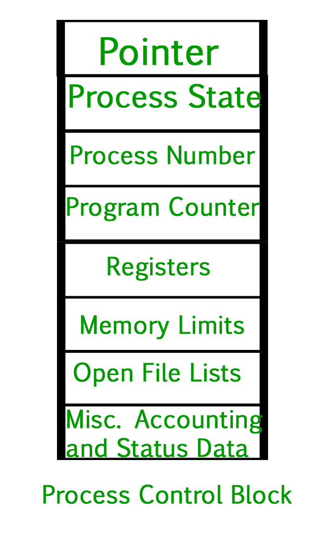

Slide 11
how would you explain the concept of memory to a layman
A memory is just like a human brain. It is used to store data and instructions. Computer memory is the storage space in the computer, where data is to be processed and instructions required for processing are stored. The memory is divided into large number of small parts called cells.

Slide 12
What is main memory explain with example?
Main memory is where programs and data are kept when the processor is actively using them. When programs and data become active, they are copied from secondary memory into main memory where the processor can interact with them. A copy remains in secondary memory.
Main memory is intimately connected to the processor, so moving instructions and data into and out of the processor is very fast.
Main memory is sometimes called RAM. RAM stands for Random Access Memory. "Random" means that the memory cells can be accessed in any order. However, properly speaking, "RAM" means the type of silicon chip used to implement main memory.

Slide 13
What are deadlocks?
A Deadlock is a situation where each of the computer process waits for a resource which is being assigned to some another process.
In this situation, none of the process gets executed since the resource it needs, is held by some other process which is also waiting for some other resource to be released.

Slide 14
Let us assume that there are three processes P1, P2 and P3. There are three different resources R1, R2 and R3. R1 is assigned to P1, R2 is assigned to P2 and R3 is assigned to P3.
After some time, P1 demands for R2 which is being used by P2. P1 halts its execution since it can't complete without R2. P2 also demands for R3 which is being used by P3. P2 also stops its execution because it can't continue without R3. P3 also demands for R1 which is being used by P1 therefore P3 also stops its execution.

Slide 15
Conditions for Deadlock
Mutual Exclusion: When two people meet in the landings, they can’t just walk through because there is space only for one person. This condition allows only one person (or process) to use the step between them (or the resource) is the first condition necessary for the occurrence of the deadlock.
Hold and Wait: When the two people refuse to retreat and hold their ground, it is called holding. This is the next necessary condition for deadlock.
No Preemption: For resolving the deadlock one can simply cancel one of the processes for other to continue. But the Operating System doesn’t do so. It allocates the resources to the processors for as much time as is needed until the task is completed. Hence, there is no temporary reallocation of the resources. It is the third condition for deadlock.
Circular Wait: When the two people refuse to retreat and wait for each other to retreat so that they can complete their task, it is called circular wait. It is the last condition for deadlock to occur.

Slide 16
What is Thread?
A thread is a flow of execution through the process code, with its own program counter that keeps track of which instruction to execute next, system registers which hold its current working variables, and a stack which contains the execution history.
A thread shares with its peer threads few information like code segment, data segment and open files. When one thread alters a code segment memory item, all other threads see that.

Slide 17
Difference between Process and Thread
S.N. | Process | Thread
1 | Process is heavy weight or resource intensive. | Thread is light weight, taking lesser resources than a process.
2 | Process switching needs interaction with operating system. | Thread switching does not need to interact with operating system.
3 | In multiple processing environments, each process executes the same code but has its own memory and file resources. | All threads can share same set of open files, child processes.
4 | If one process is blocked, then no other process can execute until the first process is unblocked. | While one thread is blocked and waiting, a second thread in the same task can run.
5 | Multiple processes without using threads use more resources. | Multiple threaded processes use fewer resources.
6 | In multiple processes each process operates independently of the others. | One thread can read, write or change another thread's data.

Slide 18
Multithreading Models
In a combined system, multiple threads within the same application can run in parallel on multiple processors and a blocking system call need not block the entire process. Multithreading models are three types
Many to many relationship.
Many to one relationship.
One to one relationship.

Slide 19
What is Interrupt in OS?
An interrupt is a signal emitted by hardware or software when a process or an event needs immediate attention.
It alerts the processor to a high-priority process requiring interruption of the current working process.
In I/O devices, one of the bus control lines is dedicated for this purpose and is called the Interrupt Service Routine (ISR).
When a device raises an interrupt at the process, the processor first completes the execution of an instruction.
Then it loads the Program Counter (PC) with the address of the first instruction of the ISR.
Before loading the program counter with the address, the address of the interrupted instruction is moved to a temporary location. Therefore, after handling the interrupt, the processor can continue with the process.

Slide 20
DEFRAGMENTATION
Disk Fragmentation : Fragmentation of disk means allocating data in non-sequence form.
Usually, data is stored in hard drive in sequence form and data header is keep following incoming data so that it is easy to read data efficiently but when we delete some older data from this sequence.
Sequence of data management is disturbed and data is looking like scatter form and also when we update older data with a bigger size of data Operating System split entire data into small packets and store data in different locations of storage area

Slide 21
Types Of Fragmentation :
Internal Fragmentation –
Internal fragmentation happens when memory is split into mounted sized blocks. Whenever a method request for memory, mounted sized block is allotted to method. just in case memory allotted to method is somewhat larger than memory requested, then distinction between allotted and requested memory is that internal fragmentation.
External Fragmentation –
External fragmentation happens when there’s a sufficient quantity of area within memory to satisfy the memory request of a method. however, the process’s memory request cannot be fulfilled because the memory offered is during a non-contiguous manner. Either you apply a first-fit or best-fit memory allocation strategy it’ll cause external fragmentation.

Slide 22
Difference between multiprocessing and multithreading
Multiprocessing uses two or more CPUs to increase computing power, whereas multithreading uses a single process with multiple code segments to increase computing power.
Multiprocessing increases computing power by adding CPUs, whereas multithreading focuses on generating computing threads from a single process.
Multiprocessing is used to create a more reliable system, whereas multithreading is used to create threads that run parallel to each other.
Multiprocessing requires a significant amount of time and specific resources to create, whereas multithreading is quick to create and requires few resources.
Multiprocessing executes many processes simultaneously, whereas multithreading executes many threads simultaneously.
Multiprocessing creates a separate address space for each process, whereas multithreading uses a common address space for all the threads.

Slide 23
DIFFERENCE BETWEEN PAGING AND SEGMENTATION
S.NO | Paging | Segmentation
1. | In paging, the program is divided into fixed or mounted size pages. | In segmentation, the program is divided into variable size sections.
2. | For the paging operating system is accountable. | For segmentation compiler is accountable.
3. | Page size is determined by hardware. | Here, the section size is given by the user.
4. | It is faster in comparison to segmentation. | Segmentation is slow.
5. | Paging could result in internal fragmentation. | Segmentation could result in external fragmentation.
6. | In paging, the logical address is split into a page number and page offset. | Here, the logical address is split into section number and section offset.
7. | Paging comprises a page table that encloses the base address of every page. | While segmentation also comprises the segment table which encloses segment number and segment offset.
8. | The page table is employed to keep up the page data. | Section Table maintains the section data.
9. | In paging, the operating system must maintain a free frame list. | In segmentation, the operating system maintains a list of holes in the main memory.

Slide 24
System Call
a system call is the programmatic way in which a computer program requests a service from the kernel of the operating system it is executed on.
A system call is a way for programs to interact with the operating system.
A computer program makes a system call when it makes a request to the operating system’s kernel.
System call provides the services of the operating system to the user programs via Application Program Interface(API).

